Slide 1
Privacy, and Copyright
Miranda Mowbray
miranda.mowbray@bristol.ac.uk
not a lawyer
Notes:
I’m not a lawyer. I will be talking about legal issues in this session. If you think you need to apply something I say that has legal implications, check with a lawyer.

Slide 2


René Carmille
Photo of Rene Carmille: Public domain via Wikimedia, https://en.wikipedia.org/wiki/Ren%C3%A9_Carmille#/media/File:Carmille.jpg
Tabulator photo: United States Holocaust Memorial Museum, https://collections.ushmm.org/search/catalog/irn521586
Technisches Museum Dresden Collection Image, 1990.48.1 Dehomag D11 tabulator
Notes:
I think you should all know about Rene Carmille. He was the head of the national statistical service in Vichy France during the second world war. That machine on the right is a 1940s computer of the kind he used, a Hollerith tabulator taking punch cards. Rene’ Carmille’s organization was asked to produce a national database of all the Jews. He basically sabotaged this, by using delaying tactics and putting resources into other projects. When in 1942 the order came to round up and deport all the Jews in France, there was no database, and the police had to use their own local records, which were patchy. There were acts of resistance by a lot of brave people, including members of the French police, which also reduced the death toll. But a very large number of French Jews, it’s been estimated tens of thousands of them, survived just because of Rene Carmille.

Slide 3
This session includes
- Privacy
Copyright & gen AI training: topic from Jack
Virtual office hour: email me
Slides, with references, will be on web site
Notes:
I was asked to do a session on privacy. Jack suggested I talk about copyright and generative AI training, which is a very hot topic right now. In this session I’ll also tell you what you can do if you find yourself involved with something at work that you think is unethical.
If you’d like to have a virtual office hour, email me and I’ll set up one.

Slide 4


Privacy
Photo of Cocoa clickit07 on Flickr
https://www.flickr.com/photos/clickit07/2049222966/

Slide 5
Definitions
Information privacy: the right to some control over how your personal information is collected and used.
Personal information:
data relating to identifiable individual
e.g. identifiable by name, ID #, location data, online ID, combination of factors - UK GDPR Article 4
Notes:
Incorrect information relating to an identifiable individual is still personal information. Identifiable means that the individual can be identified by information reasonably likely to be available to you or a person processing the data. What identifies an individual could be a name or a customer number or could include other identifiers such as an IP address or a cookie identifier, or other factors, including a combination of factors, for instance if you know my postcode and my age to within a decade that identifies me uniquely. There are a lot of tools that claim to be able to remove personal data from a data set, and they can remove the obvious stuff, but they’re unlikely to be able to deal with things like the combination of postcode and approximate age, so it can be hard to remove personal data entirely.

Slide 6
Data protection guidance
Information Commissioner’s Office, http://www.ico.org.uk
+ Data Protection Officer (DPO)
Pre-reading documents:
- AI data protection toolkit
- “How do we do a DPIA”? (Data Protection Impact Assessment)
Practical suggestions: toolkit column I, DPIA step 6.
Notes:
The website for the Information Commissioner’s Office has good guidance.

Slide 7
Right to be informed of AI training use
You must inform individuals if their personal data is going to be used to train an AI system
Including if data was originally obtained for another use
- if data not obtained directly, inform within a month
If disproportionately difficult to communicate directly, take appropriate measures: “For example, you could provide public information explaining where you obtained the data from that you use to train your AI system, and how to object”.
- ICO, “How do we ensure individual rights in our AI systems?”
Notes:
The ICO also says in another document that this still applies if the data is public, and if you can’t communicate directly but are taking other measures you need to do a DPIA as well.

Slide 8
Have I Been Trained?
http://haveibeentrained.com
Search the LAION dataset for images,
opt out of future AI training use
- respected by Stability AI and HuggingFace
Lapine (digital artist) found medical photos of herself
“It’s bad enough to have a photo leaked, but now it’s part of a product”
- Ars Technica, 21 Sept 2022, “Artist finds private medical records in popular AI training dataset”
Notes:
Lapine had authorized no use of the photos except in her personal medical file, to be shared with no-one. The photos had somehow got onto the internet, and from there was collected into the LAION database.
Warning: the NSFW filter in haveibeentrained.com doesn’t catch everything, so if you check it you might see something you wish you hadn’t.

Slide 9
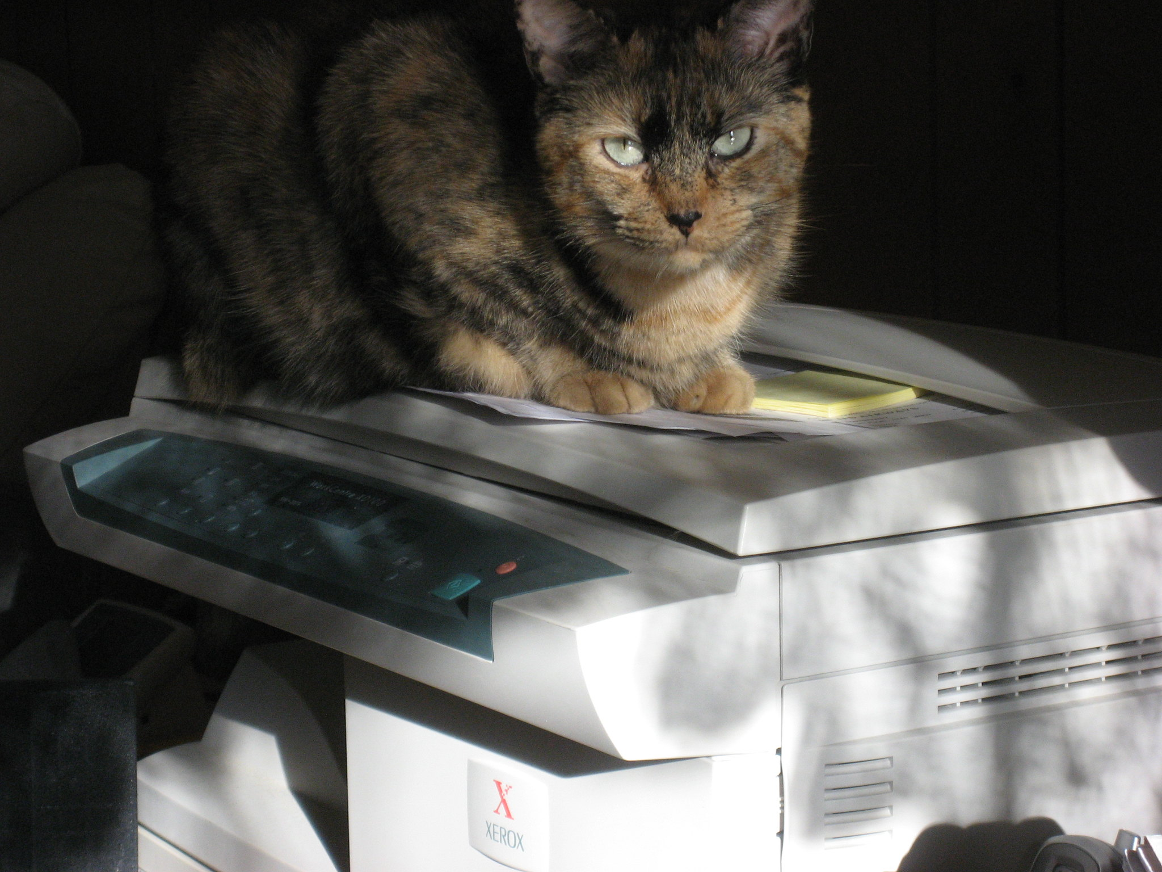

Copyright
Photo Mighty Free / mighty_free on Flickr
https://www.flickr.com/photos/mighty_free/2208726259

Slide 10
Copyright - background
Limits the copying and distribution of original artistic (literary, musical) works
Protects the fixed expression of an idea
- not the idea itself, or the artist’s style
Exceptions for various uses
- UK Intellectual Property Office, “Exceptions to Copyright”
Balances:
- incentivizing production of original creative works
- enabling citizens to access these works easily
Notes:
Copyright is for original artistic works in fixed form. So spoken words are not copyright but a recorded speech is. Software is considered a literary work. You get copyright on your work automatically when you create it in fixed form. If two people independently come up with the same expression, they each get copyright in their own work, because copyright restricts copying, not creation.
Copyright is about technology. Before small printing presses were available, there was no copyright. The small printing presses made it a lot cheaper to copy someone’s work than create a new work. Copyright expires after the copyright term, and there are also exemptions, that is, uses of copyright works that are allowed without permission from the copyright holder. In the UK these include comment, criticism, some limited research uses, helping disabled people, and some other things – see the reference for a full list. Copyright law is a balance between incentivizing the production of creative works, which is a reason for restricting the copying and distribution, and allowing access to them for socially useful purposes, which is a reason for not restricting them. Every time there’s a new technology for creating, copying or distributing work, the balance may need to be reconsidered, and that’s why questions about copyright and generative AI are a hot topic right now.

Slide 11
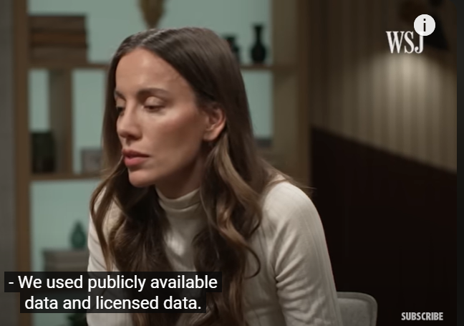
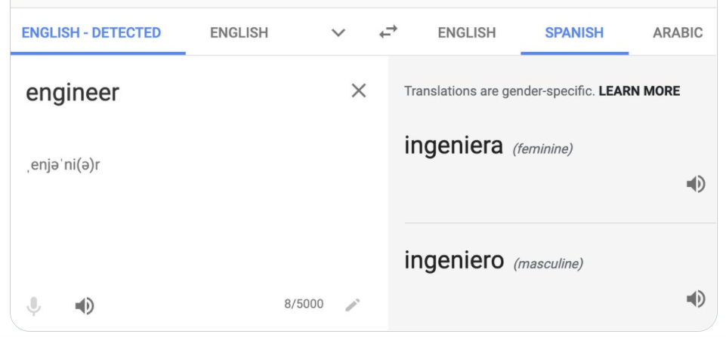
“What data was used to train Sora?”
Mira Murati, then OpenAI CTO, interviewed by Joanna Stern of Wall Street Journal. Online 13 Mar 2024
Still at 4:27 (cropped)
Notes:
This picture is copyright of the Wall Street Journal. I can show it to you because of a copyright exemption. In UK law there are some rather narrowly-drawn exemptions for educational use, one of which is use of a copyright image in a course at a recognized educational establishment in order to make a point related to the course. I have to not show you more than is necessary to make the point, and to give sufficient credit.
Mira Murati, then CTO of OpenAI, is asked by Joanna Stern what data was used to train Sora. She says, we used publicly available data and licenced data.
Joanna Stern then asked “So, videos on YouTube”.

Slide 12

“So, videos on YouTube.”
Mira Murati, then OpenAI CTO, interviewed by Joanna Stern of Wall Street Journal. Online 13 Mar 2024
Still at 4:34 (cropped)
Notes:
Mira Murati makes this face.
In copyright law, just because something’s publicly available to read doesn’t necessarily mean that you have the right to use it in ways other than reading it, unless there’s a copyright exemption.

Slide 13
Training AI on copyright works
Is it OK to train AI on copyright works available on the Internet, without the copyright holders’ consent?
Notes:
What do you think?

Slide 14
Training AI on copyright works without consent
EU: legal for any use unless copyright holder opts out
– EU AI Act recital 105
UK: legal for research use, given lawful data access
Data (Use and Access) Bill
- draft bill: as EU
- Lords amendments: crawler transparency, point of contact for copyright holders to object, data transparency (articles 135-137)
- may be re-amended
US: unclear, experts disagree.
Notes:
The amendment about web crawlers says they need to inform web site owners of the purpose they’re gathering data for, and give a point of contact for copyright holders to object. The amendment about data transparency says that the operators of web crawlers and gen AI models have to say where they got their data, giving enough information that copyright holders can work out whether their works have been trained on. There are counter-amendments and we don’t know whether the law will be passed, so it’s all a bit unclear at the moment.

Slide 15
Some US cases active in Feb 2025
Book authors: Kadrey v Meta, Bartz v Anthropic, Authors Guild v OpenAI, Sancton v OpenAI, Tremblay v OpenAI, Nazemian v NVIDIA , Dubus v NVIDIA, O’Nan v Databricks
YouTube content owners: Millette v OpenAI, Millette v Google,
Millette v NVDIA
Music companies: UMG Recordings v Suno, UMG Recordings v Uncharted Labs, Concord Music Group v Anthropic
Artists: Andersen v Stability AI
Voice artists: Vacker v ElevenLabs
Newspapers/journalists: Center for Investigative Reporting v OpenAI and Microsoft, Daily News v Microsoft, New York Times v Microsoft, Advance Local Media v Cohere AI, Dow Jones v Perplexity AI,
Raw Story v OpenAI
- Free Law Project’s AI cases bot
Notes:
Some of these are class action cases, so not just one company sueing but a large number in the same media industry. This is just cases about training on copyright data. (The bot also follows some other AI copyright-related cases).
One argument being used by plaintiffs is that because of memorization, sometimes generative AI can generate output that is identical or near-identical to items in the training data, and maybe that’s copyright infringement, so the AI companies are enabling their users to do copyright infringement (deliberately or unwittingly). The other is that in order to train the AI at all the companies have to copy the data, and maybe copying the data for that purpose is copyright infringement.

Slide 16
Training gen AI on YouTube videos
According to the New York Times:
OpenAI scraped >1m hrs of YouTube videos, converted the audio to text using Whisper, used it for training GPT-4
- against both Terms of Service and robots.txt
Google also used YouTube transcripts for training AI “in accordance with our agreements with YouTube content creators”
- Cade Metz et al, “How tech giants cut corners to harvest data for A.I.”, NY Times 6 Apr 2024
Notes:
Google’s privacy policy says that they use some publicly available data to train their AI – but it doesn’t say which publicly available data, and it took some Youtube creators by surprise that their videos were used.

Slide 17
Kadrey v Meta 😂
Appears not to be disputed:
- Meta downloaded LibGen, a “shadow library” of millions of books & articles, and used it in training LLaMa 3 (document 441-1)
- Downloaded part of it via torrent, with minimal seeding (395-6)
“If there is media coverage suggesting that we have used a dataset that we know to be pirated, such as libgen, this may undermine our position with regulators” (396-2)
“In no case would we disclose publicly that we had trained on libgen” (also 396-2)
“using pirated material should be beyond our ethical threshold.” (441)
“torrenting from a corporate laptop doesn’t feel right 😂“ (396-3)
Meta’s lawyers say this was all legal. It could be.
Notes:
The quotes are by Meta employees in internal communications that were revealed during document discovery for this case.

Slide 18
Suggestions
Licencing agreements – e.g. academic publishers, Adobe Firefly
Input & output filtering – e.g. Udio, ChatGPT, Claude
Indemnification for users – e.g. ChatGPT, Copilot
Transparency of data sources, crawler transparency
Opt-out mechanisms
Efficient unlearning of item : - e.g. Bourtoule et al, research problem
Collective copyright management for artist royalties / credit
research problem
Notes:
Some of these suggestions are just about training on copyright data, some also apply to training on personal data,

Slide 19
What can you do?
What can you do if you find yourself involved in something ethically bad at work?
Notes:
Now I’m going to talk about what you can do if you find yourself involved with something bad at work. For instance, if you’re the Meta employee who thought it should beyond an ethical threshold to use pirated data.

Slide 20
What can you do?
#1: don’t get into this situation in the first place
Due diligence in job applications
May be possible to evade problem
Keep your compass: have more than one community
Routinely think about ethical issues of your work (increase +ve as well as avoid –ve)
Notes:
First, don’t get into this position in the first place. When you’re applying for jobs, read up about the companies you’re thinking of applying to and check that you’d be comfortable with their business. I’ve always brought up ethics in job interviews if they didn’t bring it up first, and it’s never gone down badly. The interviewer may well bring it up first, as ethical considerations are an increasingly important part of an AI researcher’s job. Even rather dodgy tech companies can think of themselves as very ethical, so do judge them by what they do rather than whether they say they’re ethical.
Once you’ve joined, it may be possible to evade ethical problems, for example you may opt to work for one part of the company rather than another or avoid particular projects. One possibility though is to stay with a project that has a risk of going bad because you think you are likely to be able to steer it in the right direction.
Keep your compass. Something that sometimes happens to people in start-ups, is that you’re working very long hours and socialize with your colleagues, and so everyone you meet is convinced that what the company’s planning is good, but if you asked anyone outside they’d say “what are you THINKING of?” To help keep your ethical compass, it’s a good idea to have more than one community. (This has other benefits too.) For instance, as a PhD student you may have your community of graduate students you hang out with, your family and friends from home, and another community of people connected with a hobby. Three is a good number of communities, it’s good to be in three communities that have different outlooks. For instance, if all your friends voted Leave or all your friends voted Remain, there may be conversations you’re missing that it would be useful for you to hear.
Finally, to avoid getting into this situation, I suggest routinely thinking about ethical issues of your work. As computer scientists, you routinely think about whether you can make your code more accurate, or more efficient, or more reusable. You could also routinely think about whether you can make the code and its application more in line with your values. Ethics can be about improving something that’s already good, not just about avoiding disasters.

Slide 21
What can you do? #2
#2: talk about it within the team/organization
Get allies
Look for corporate rules / outcomes / values supporting your case
Be factual
Suggest solutions if you can
If low-key informal approach isn’t enough, use company reporting procedures where they exist
Notes:
Now suppose that you didn’t manage to avoid the situation. You’re involved at work with something you think is bad. What do you do now? Sometimes it may be something that you can fix just by yourself, for example by choices in your coding, without having to get anyone else on board, in which case, just do it. But I’m assuming that’s not the case. The next stage is to talk about it within your team, and then if necessary, with the wider company. Get allies; it’s much easier to get a company to change what they’re doing if you’re not the only one asking for that. Start with the assumption that you’ll be listened to positively. Talk first with your peers, and your manager. If your manager isn’t sympathetic, you can talk with THEIR manager (and up the management chain): I’ve done that, it worked gratifyingly well.
When you’re talking about it, don’t refer to your personal rules or values, instead look for corporate outcomes, rules or values supporting your case. You may be able to make a financial argument; if you can find another company that did a similar thing, and had a scandal and a drop in its share price or lost a lot of customers, that argument can be a strong one in industry. Perhaps what you object to breaks a national or international law or a regulation – for some people, though not all, that’s the end of the discussion. Or perhaps it goes against one of the company’s publicly stated values.
I should perhaps say that using a financial argument may depend on what kind of problem it is and what the company is like. I’ve heard it said that if you use a financial argument for an ethical issue, you’ll lose. However, sometimes potential allies who actually want to agree for other reasons find it easier to sell a financial argument than a purely ethical one. And in cases where there’s good evidence that doing the right thing would also be financially beneficial, for instance increasing workforce diversity, then I don’t see why you shouldn’t make that argument.
Be factual – make sure you can give evidence to back up what you say. Keep personal grievances out of it. It may be that a manager acted unethically and also passed you over for a promotion: in that case don’t mention your non-promotion when you’re talking about the unethical behaviour, it’s a separate conversation. Suggest possible solutions: if a senior manager says “you’re right, what should we do about it?” you should have a suggestion ready. Perhaps take some time to collect evidence and think about feasible solutions before you talk about the problem.
Most problems get resolved at this stage, within the team or company, in an undramatic way. If however this low-key, informal approach isn’t enough, then use the company’s ethics reporting procedure if there is one. It’s important that you use it, because if the company has a reporting procedure and you don’t use it, you can lose some legal protections.

Slide 22
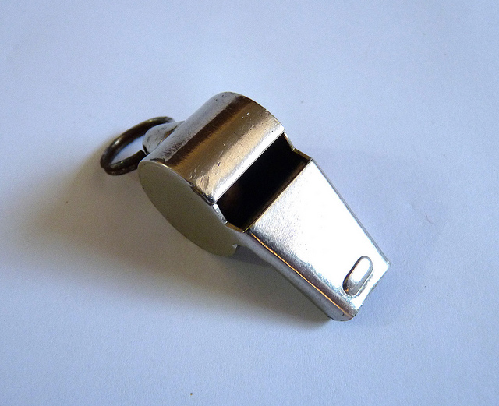

What can you do? #3
#3: Public whistleblowing (e.g. talk to journalist)
For heroes/heroines.
Only try this after #2 has failed.
Read this first: https://www.gov.uk/whistleblowing
Support organizations, see refs.
NDAs can’t prevent whistleblowing in the public interest
Photo Gail Thomas on Flickr, https://www.flickr.com/photos/42573918@N00/6421710193
Notes:
The third step is public whistleblowing; for instance, talking to a journalist. You might talk to an MP or a professional body instead, depending on the type of problem. Public whistleblowing is for heroes and heroines; don’t feel that you have to do it. Only do it after the previous steps have failed, and read the link I’ve given you first. There are support organizations for people thinking of whistleblowing, I’ve given you links in the references.
One thing worth mentioning is that non-disclosure agreements can’t prevent whistleblowing in the public interest. If a non-disclosure agreement says you can’t talk about the issue, that part of the agreement may not be valid. But whether a particular potential whistleblowing counts as being in the public interest depends on the situation, so do check with a lawyer or support organization first whether or not this is the case in your particular situation, before you whistleblow.
.

Slide 23
What can you do? Employer
If you’re an employer
Create an open and supportive culture: demonstrate you welcome discussions
Have a whistleblowing policy
See refs for UK govt guidance on this
Add incentives
- Questions in performance evaluation
- Incentivise managers for direct reports’ performance
Notes:
So far I’ve been talking from the perspective of an employee. What if you’re an employer, or a senior manager? Some of you are going to start your own companies, or be in senior management. What you should do is to create an open and supportive environment, and demonstrate that you welcome discussions. Demonstrate this, don’t just say it. You really do not want that the first you time you hear of a problem is when the Twitter hate campaign starts and journalists doorstep you. You want to hear about it at an early stage, when you have the opportunity to fix the issue without too much pain. As well as an open environment you need a reporting procedure. I’ll give you a reference on how to design one.
You should also add incentives for your employees to behave in the way you want. Think about what questions to ask in their performance evaluations or promotion applications, to let them demonstrate their ethical behavour or learning, or their following ethical procedures. Use results on how employees are doing in this regard to feed into the performance evaluation of their managers. One tool you can use for this is anonymous surveys, in which employees can say how well they think their part of the company (or, more specifically, their manager) is doing with respect to ethics.

Slide 24
This session
- Privacy
Copyright & gen AI training: topic from Jack
- What can you do?
Virtual office hour: email me
Slides, with references, will be on web site

Slide 25


References
Photo TLVshac on Flickr https://www.flickr.com/photos/shacharabiry/

Slide 26
REFERENCES I
AI and data protection risk toolkit
Information Commissioner’s Office (ICO)
From http://www.ico.org.uk search for “AI toolkit”,
download from top link, select the “Risk toolkit” tab.
See in particular Column I, "Practical steps to reduce the risk“.
ICO website: http://www.ico.org.uk

Slide 27
REFERENCES II
Privacy law, data protection guidance
UK GDPR: https://www.legislation.gov.uk/eur/2016/679/contents
Guidance from ICO:
Debunking data protection myths about AI | ICO
When do we need to do a DPIA? | ICO
How do we do a DPIA? | ICO
How do we ensure individual rights in our AI systems? | ICO
What common issues might come up in practice? | ICO
Data (Use and Access) Bill
https://bills.parliament.uk/bills/3825
Parliament TV https://www.parliamentlive.tv/Guide

Slide 28
REFERENCES III
Efficient unlearning of item
Lucas Bourtoule et al, “Machine Unlearning”
https://ieeexplore.ieee.org/document/9519428
Papers on adversarial unlearning (from Edwin Simpson):
- Zonglin Di et al, “Adversarial machine unlearning” https://openreview.net/forum?id=swWF948IiC
Jakub Łucki et al, “An adversarial perspective on machine unlearning for AI safety”
https://arxiv.org/abs/2409.18025

Slide 29
REFERENCES IV
Other privacy refs
Rene Carmille https://en.wikipedia.org/wiki/René_Carmille
Have I been trained? http://haveibeentrained.com
Benj Edwards, Ars Technica, “Artist finds private medical records in popular AI training dataset”
https://arstechnica.com/information-technology/2022/09/artist-finds-private-medical-record-photos-in-popular-ai-training-data-set/

Slide 30
REFERENCES IV
Copyright law and legal cases
UK exceptions to copyright https://www.gov.uk/guidance/exceptions-to-copyright
EU AI Act https://artificialintelligenceact.eu/
Data (Use and Access) Bill, articles 67, 135-137
https://bills.parliament.uk/bills/3825
US copyright experts disagree about AI: Silicon Flatirons, Generative AI and Copyright conference 2024, panel 1 https://www.youtube.com/watch?v=XjlhrqK80f4
Free Law Project’s AI cases bot https://x.com/ai_cases_bot
Kadrey v Meta https://www.courtlistener.com/docket/67569326/408

Slide 31
REFERENCES V
Other copyright refs
Joana Stern, Wall Street Journal: interview of Mira Murati, online 13 Mar 2024, stills at 4:27 and 4:34
https://www.youtube.com/watch?v=mAUpxN-EIgU
Wes Davis, The Verge, “OpenAI transcribed over a million hours of Youtube videos to train AI” https://www.theverge.com/2024/4/6/24122915/openai-youtube-transcripts-gpt-4-training-data-google (original investigative journalism report was Cade Metz et al, New York Times, “How tech giants cut corners to harvest data for AI”.)
Ithaka S+R, Gen AI licencing agreement tracker (academic publishers) https://sr.ithaka.org/our-work/generative-ai-licensing-agreement-tracker/

Slide 32
REFERENCES VI
Whistleblowing
- UK government advice https://www.gov.uk/whistleblowing
UK support organization https://protect-advice.org.uk/
US/International support organizations
https://whistlebloweraid.org
https://www.whistleblowers.org/
(US handbook: https://www.whistleblowers.org/book/ )
UK government guidance for employers https://www.gov.uk/government/publications/whistleblowing-guidance-and-code-of-practice-for-employers
- Whistleblowing policy for UK Government employees https://assets.publishing.service.gov.uk/media/5a7f7987ed915d74e622aaec/Whistleblowing_and_Raising_a_concern.pdf

